Slide 1
Role of tree canopy light environment
in structuring plant communities
Ashish and Jaeyoung

Slide 2
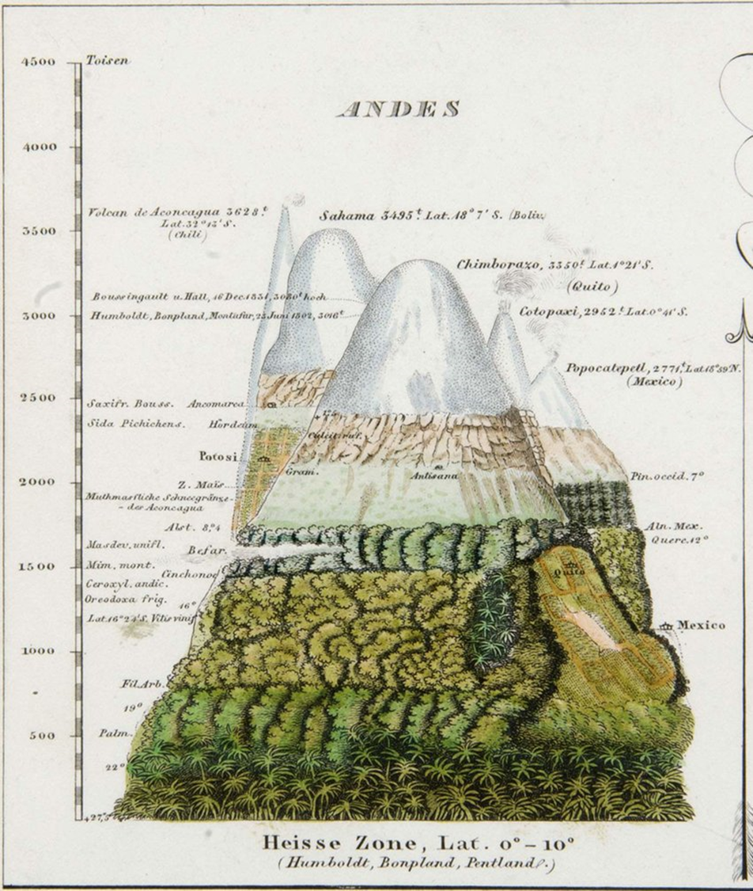
Abiotic gradients structure forest communities

Slide 3
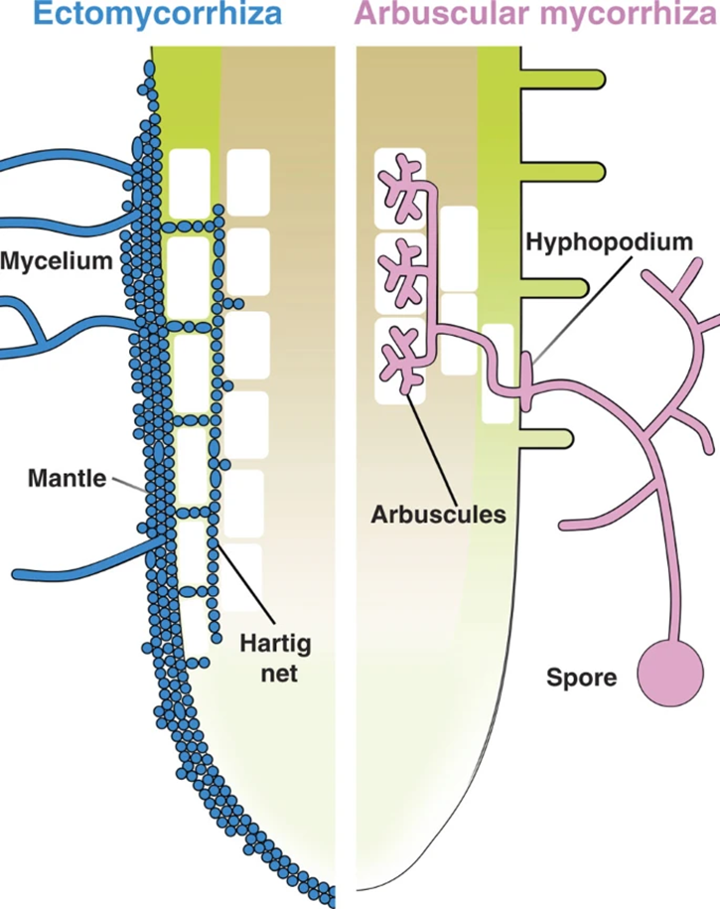
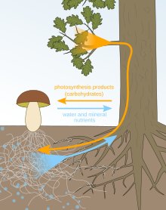
•Most tree species are known to associate with mutualistic mycorrhizal fungi to acquire scarce nutrients important for growth.
•Woody plants predominantly associate with either Arbuscular mycorrhizal fungi (AMF) or Ectomycorrhizal fungi (EMF).
•Both types of associations are related to distinctively different strategies of nutrient acquisition and cycling.

Slide 4
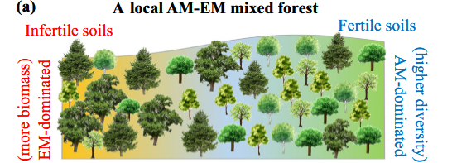
Mycorrhiza likely to mediate tree response to abiotic gradients

Slide 5
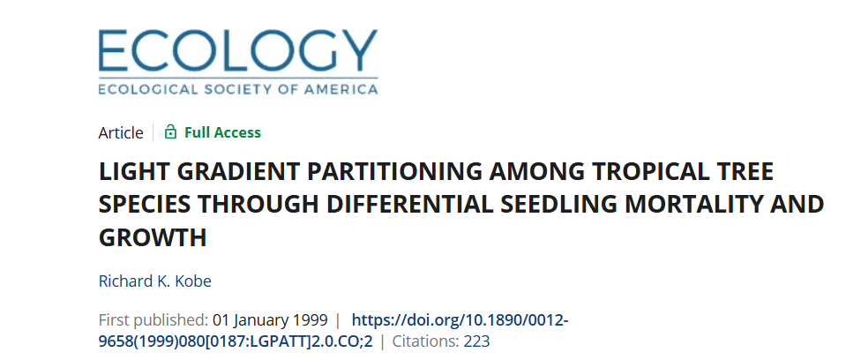

Slide 6
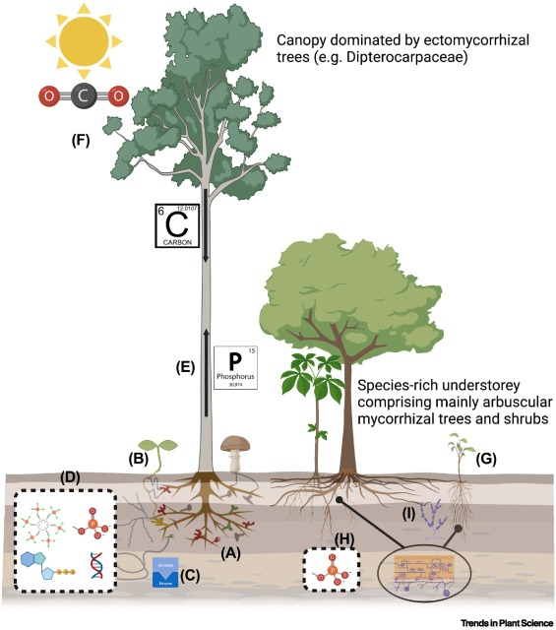
(Johnson 2023)

Slide 7
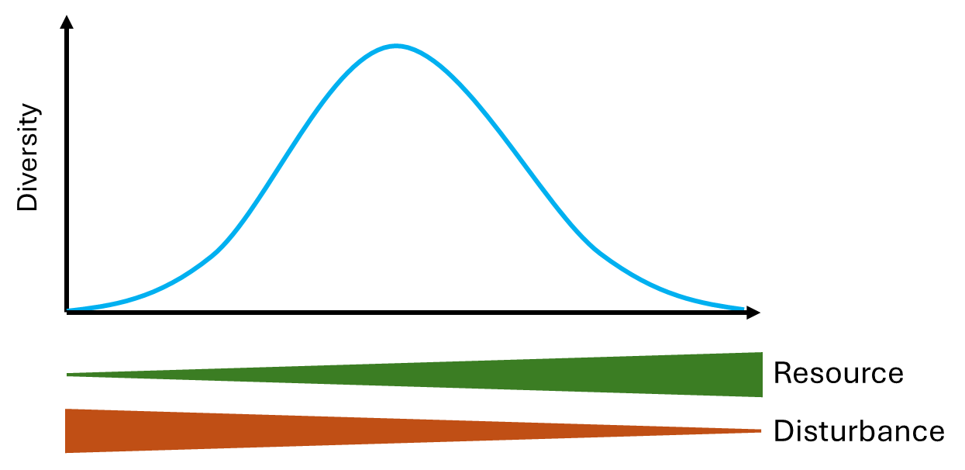
Research questions
Is vertical gradient in canopy light exposure correspond to change in species diversity?
Does the nature of mycorrhizal association affect this?
IS the tropical and temperate forest likely to have different trends?

Slide 8
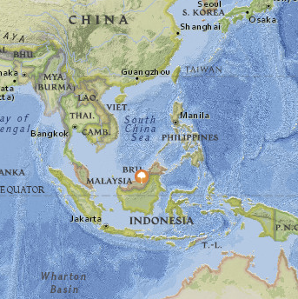
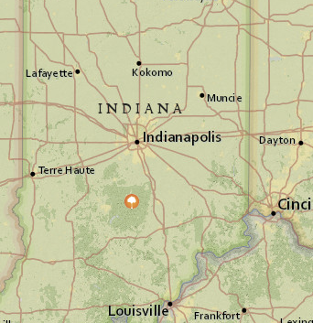
Sites
Ecosystems
Lambir Hills National Park, Malaysia (Tropical forest)
Lilly Dickey Woods, Indiana (Temperate forest)
Both, 25 ha by 30*30m grid plots
Organisms
Woody plants, sites with AM and EcM
Notes:
Lambir
The Lambir Hills Forest Dynamics Plot was initiated in 1991 in Lambir Hills National Park, Sarawak (Malaysian Borneo) by the Sarawak Forest Department, ForestGEO/Harvard University, and Plant Ecology Laboratory of Osaka City University, Japan.
Lilly Dickey Woods
The Indiana University Forest Dynamics Plot is located at the IU's Lilly Dickey Woods in Nashville, Indiana. It lies at the northern edge of the unglaciated portion of Indiana and near the center of the Eastern Broadleaf Forest Province.

Slide 9
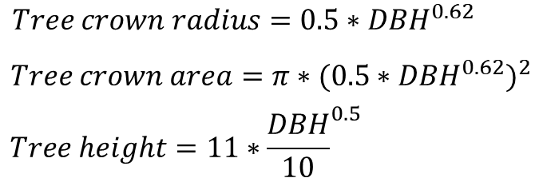
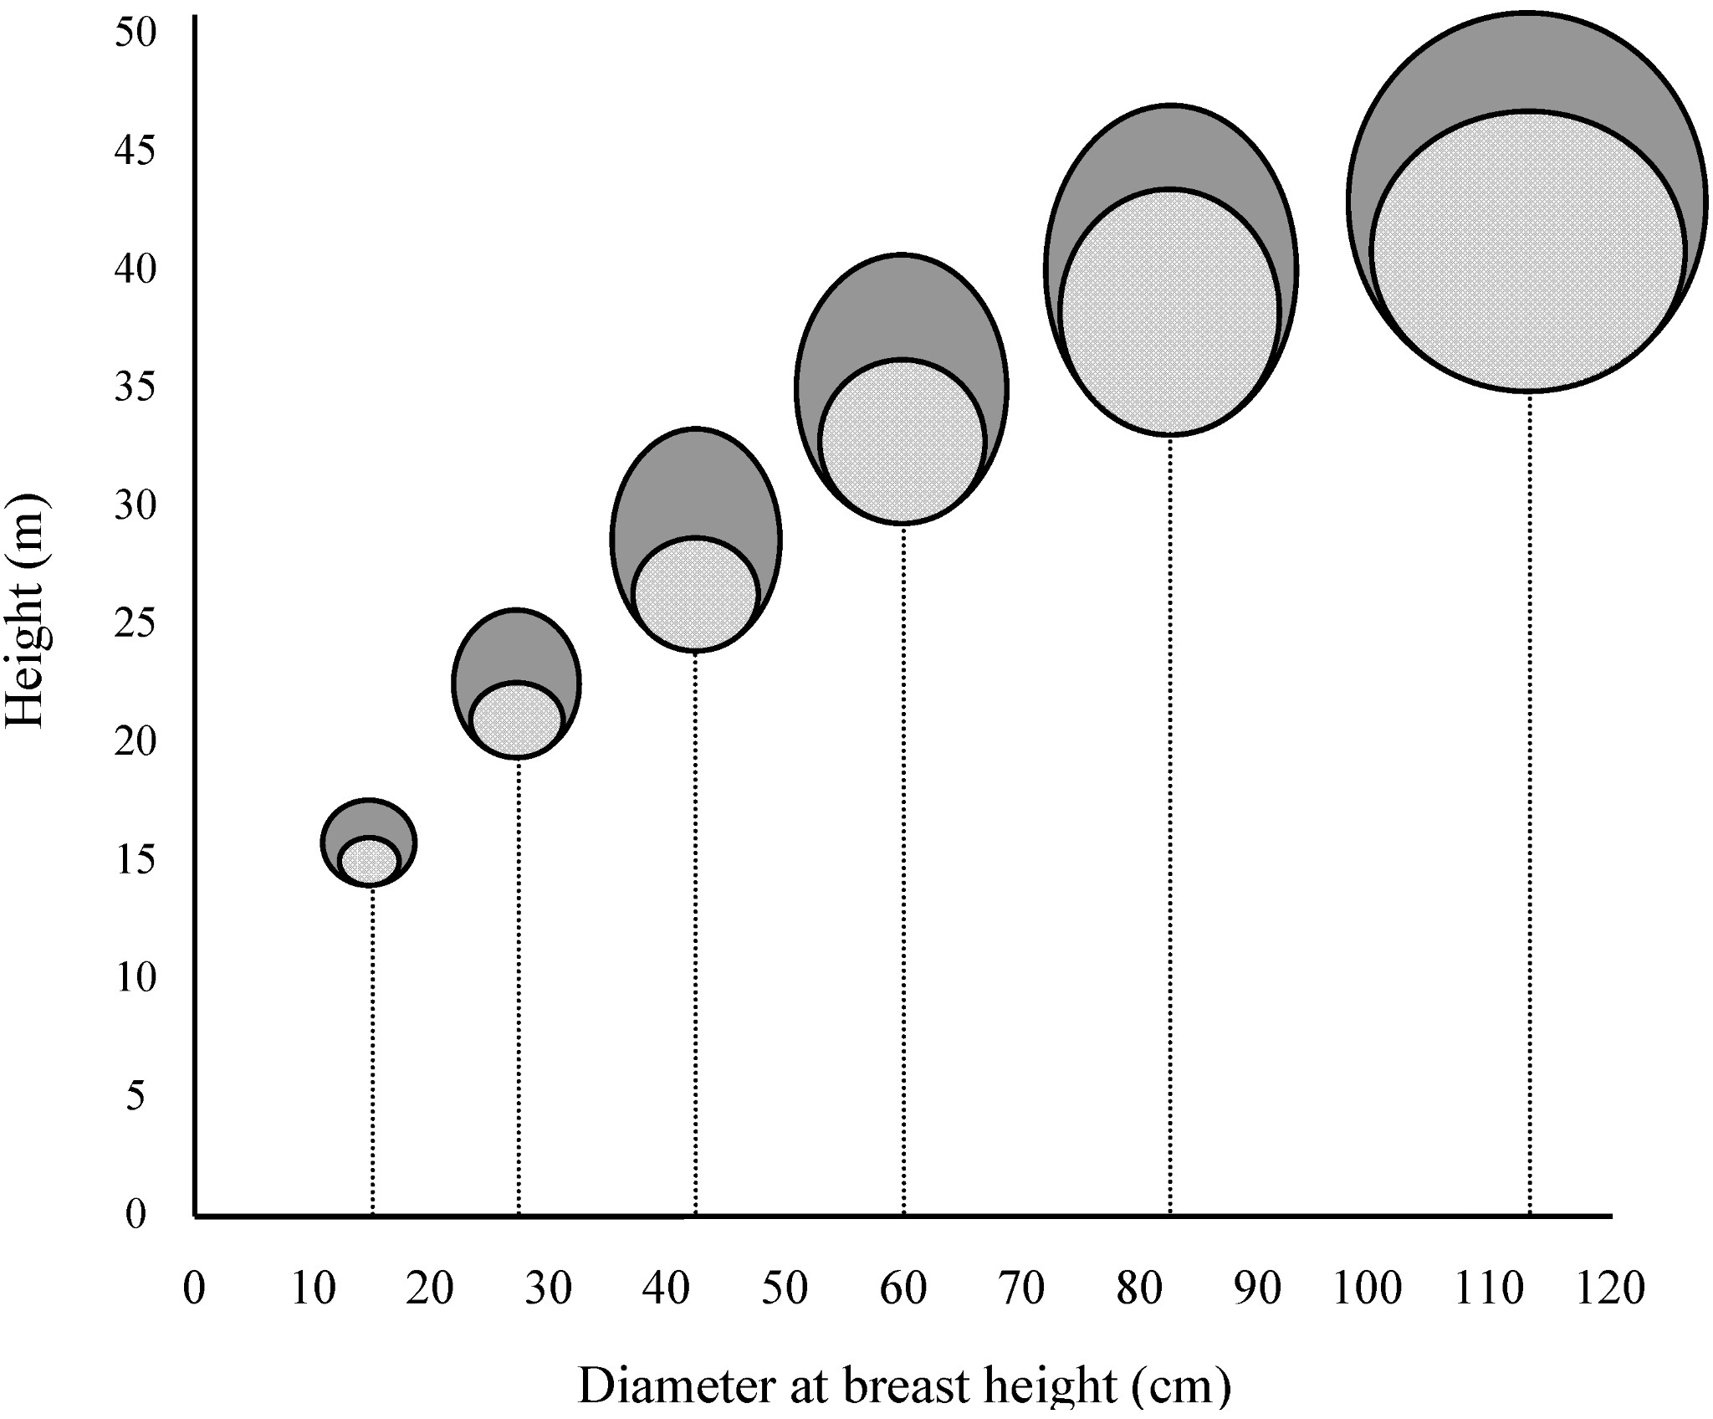
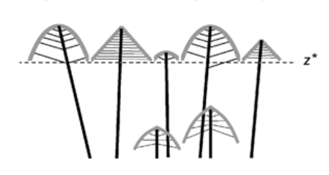
Methods - Quantifying canopy light environment
(Rüger et al., 2020)
Notes:
Highest → Lowest, fill the 30*30m grid
Sum of tree crown area > 30*30m → The next tree is assigned to canopy layer 2

Slide 10
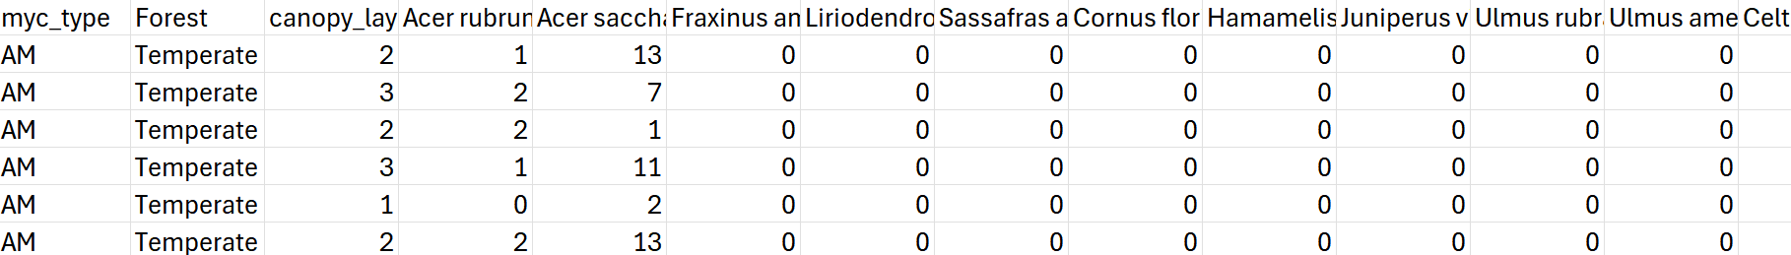
Methods - Quantifying canopy light environment
(Rüger et al., 2020)
Final data structure (n = 6773)

Slide 11
Diversity analysis
Alpha diversity calculated through Richness, Simpson’s diversity (1-D), Shannon diversity
Between groups comparison done using ANOVA
Pairwise comparison using Tukey HSD

Slide 12
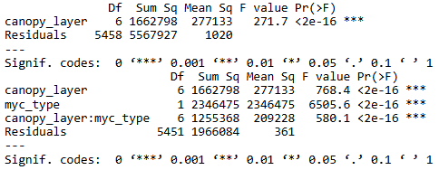
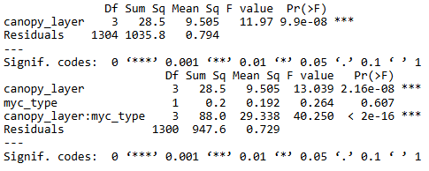
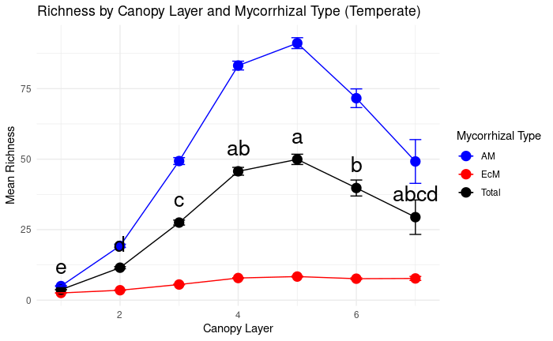
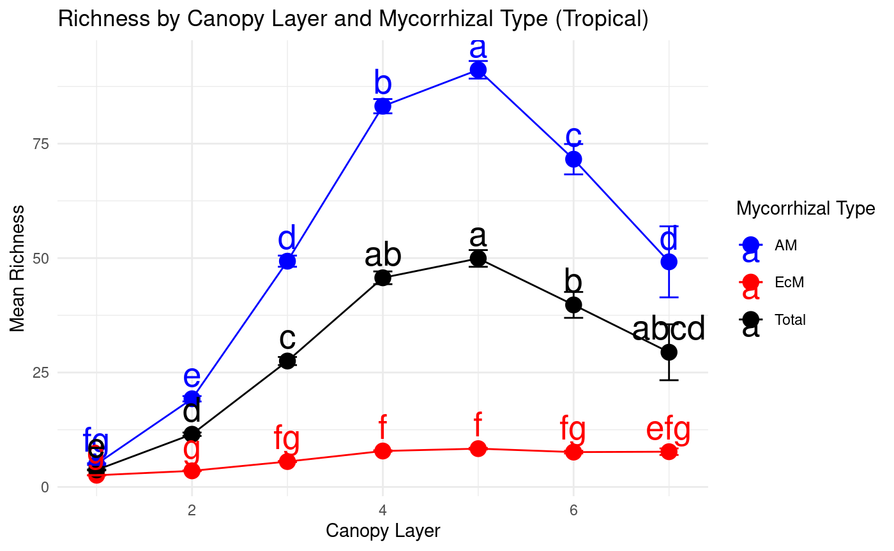
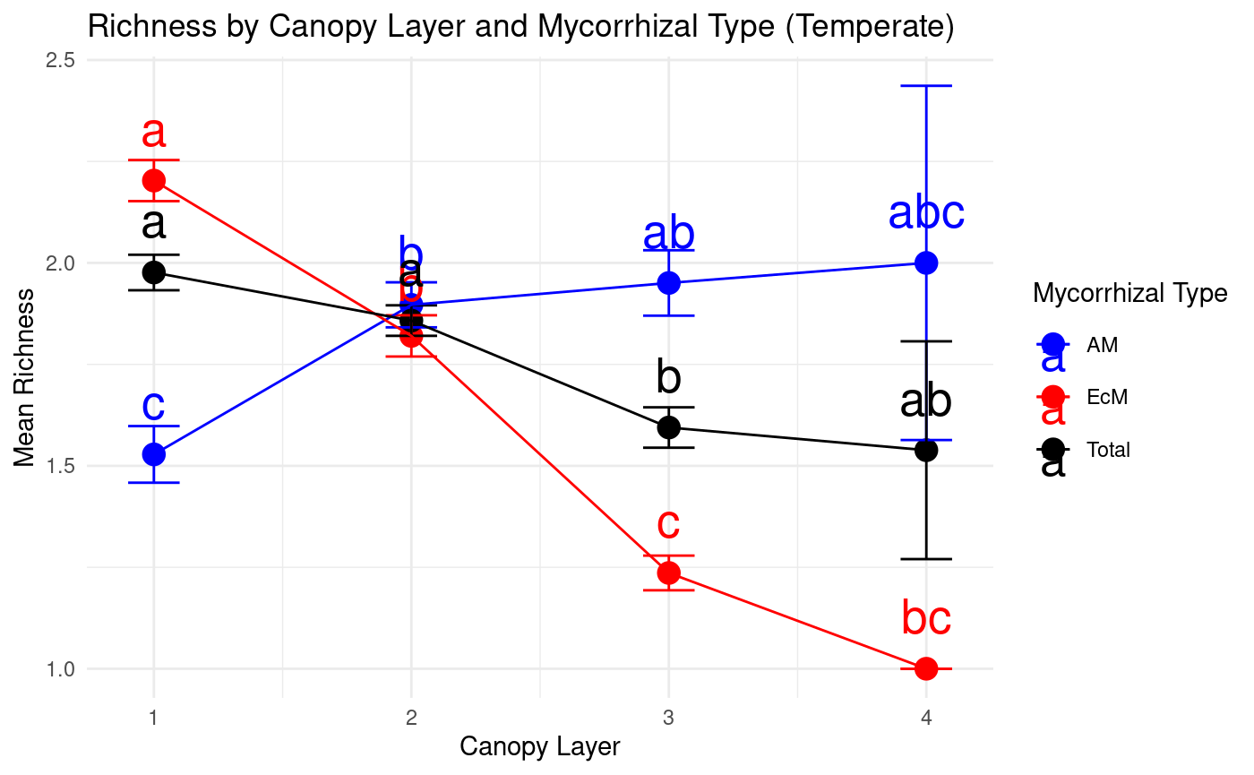
Richness
Tropical forest Temperate forest
a
b
b
e
fg
g
Notes:
Tropical: Overall species richness differs across canopy layers, highest in middle layers(5)
EcM community is overall lower in species richness and the richness remains constant/ evenly distributed across the canopy layers. However, unlike EcM community AM trees appear to have highest richness in the canopies in between layers suggesting maximum richness in the in between layers and AM drives the overall trend mostly.
Temperate: Overall species richness decreases from 1->4, species richness of EcM is greatest in canopy layer 1, which supports that EcM is more dominant and well adapted to get advantage of light.

Slide 13
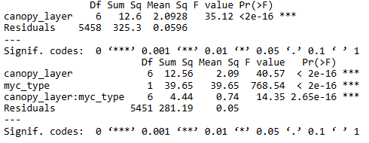
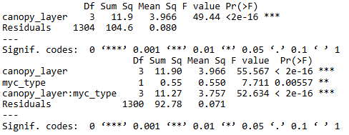
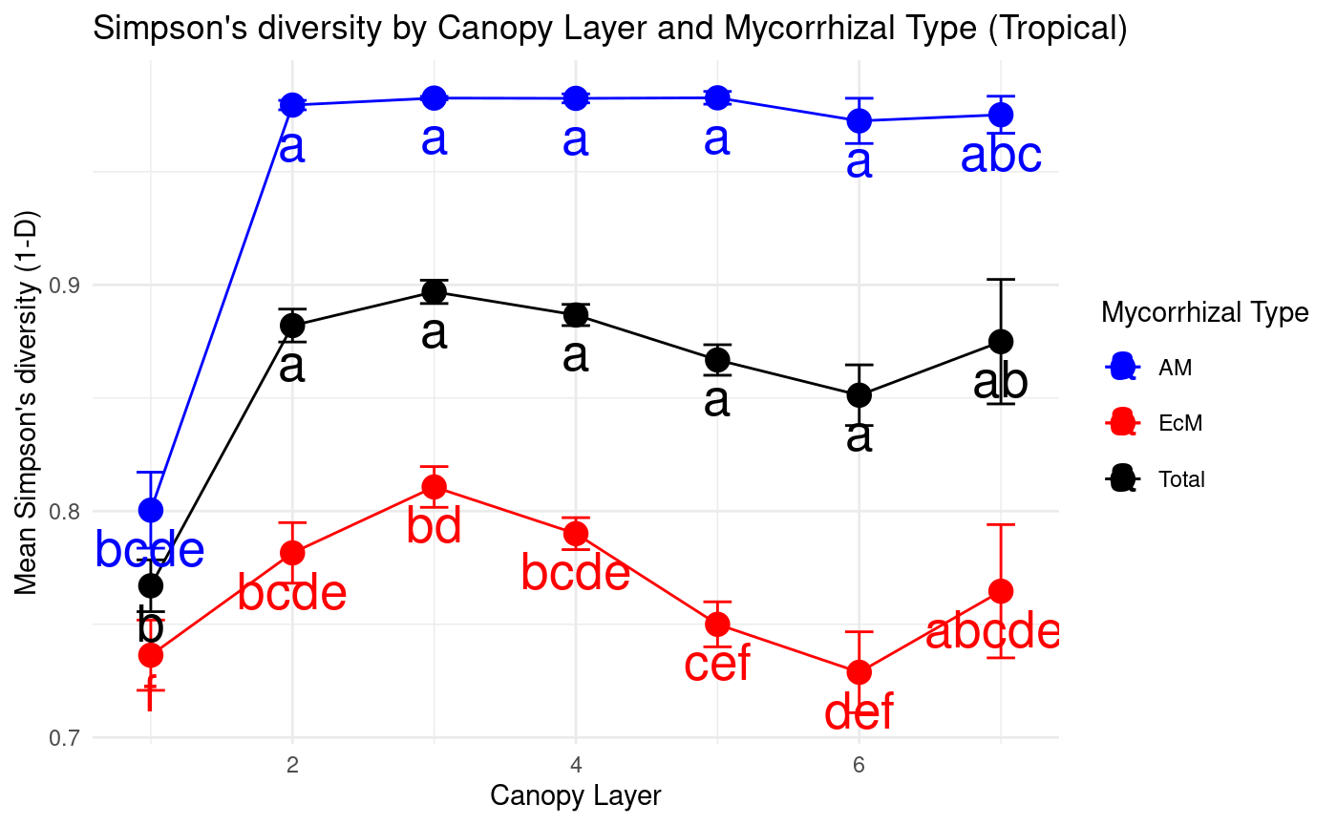
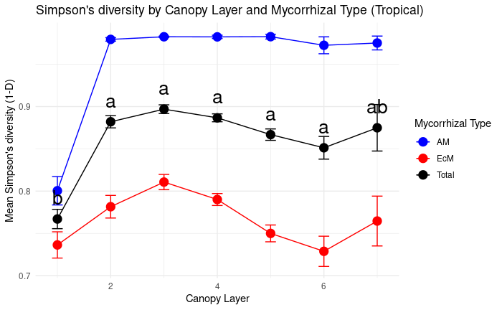
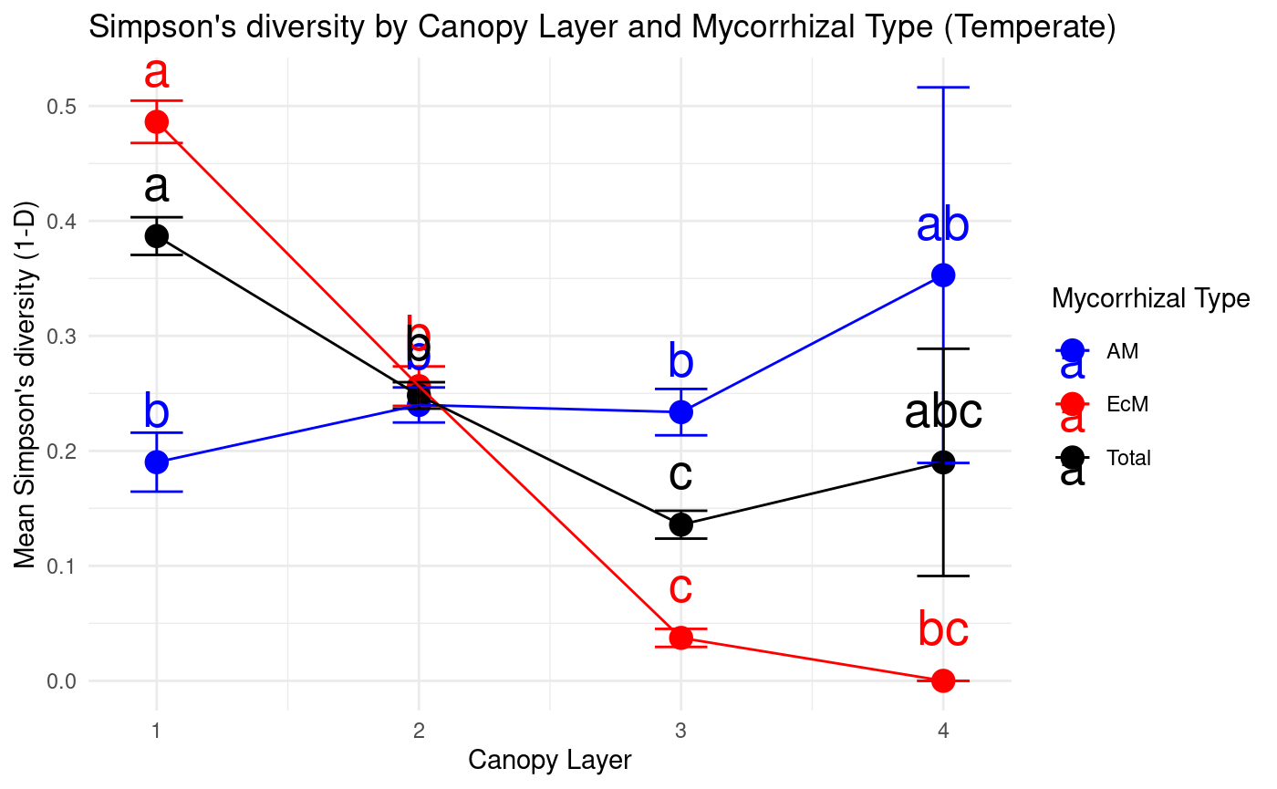
Simpson’s diversity
Tropical forest Temperate forest
b
b
b
Notes:
Richness and Simpson’s diversity: similar trend
Differencd: in tropical forest, Top canopy layer has lowest diversity compared to other canopy layers

Slide 14
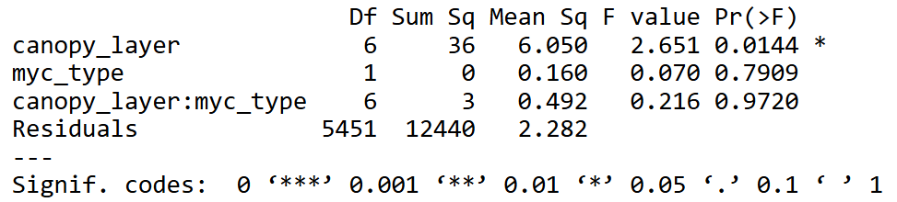
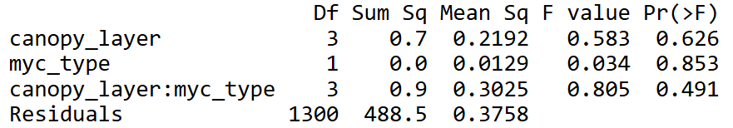
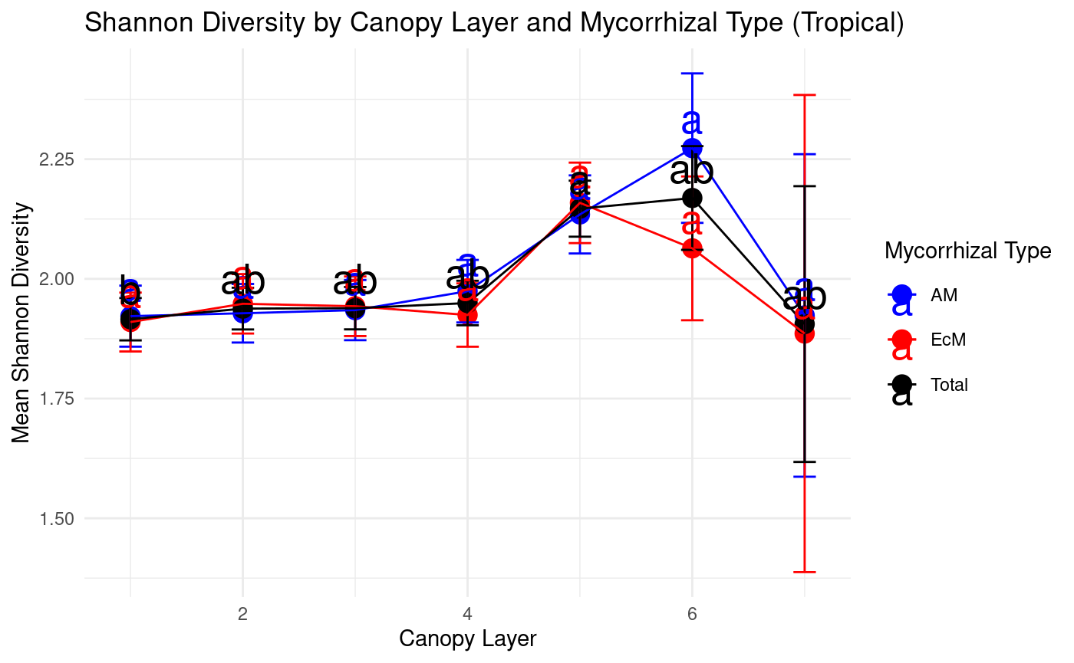
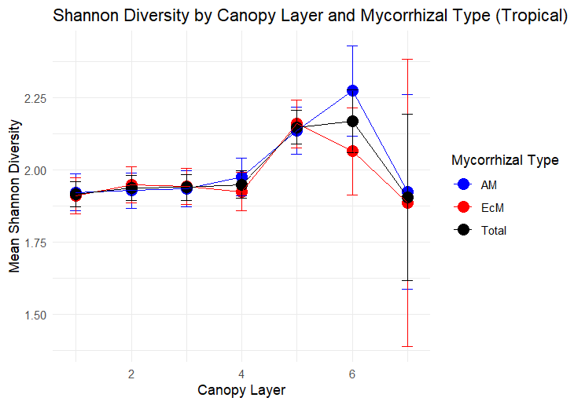
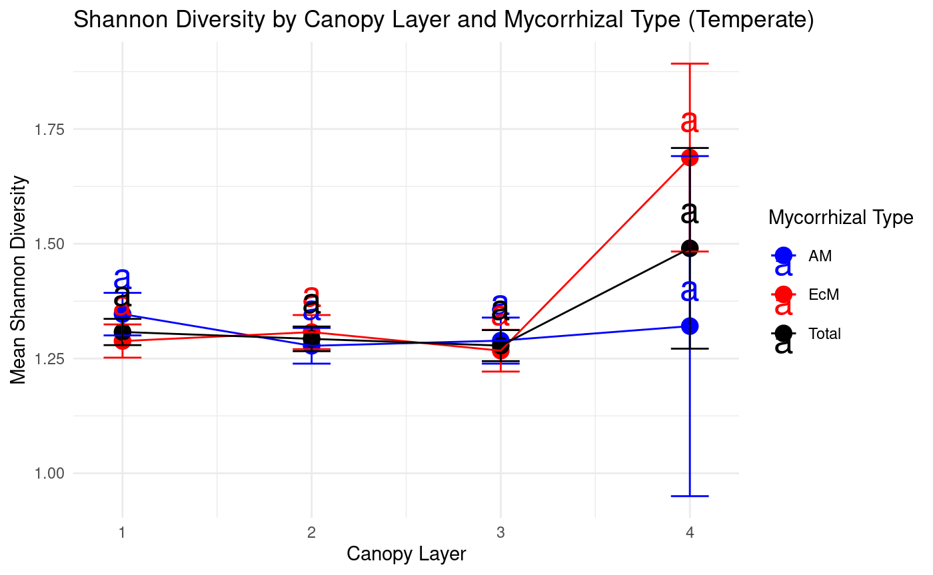
Shannon diversity
Tropical forest Temperate forest
Notes:
Tropical: Difference in shannon diversity across canopy layers, but same in AM vs. EcM
Temperate: no difference
Simpson accounts more on dominant species, while shannon on rare species -> This could lead to unmatched(?) results of Shannon and Simpson.

Slide 15
Conclusion
In Temperate forests: Overall species diversity decreases from high light environment to low light environment.
Primarily driven by dominant EcM trees.
In tropical forests : Overall, very few species appear to occupy high light environments occupy. Most species appear to occupy mid canopy positions and understory positions.
Primarily driven by dominant AM trees.
Synthesis : Most species appear to be adapted to high light environments in Temperate forests with EcMs dominating canopy.
In tropical forests : Most species appear to be adapted to low light environments with AM dominating in terms of diversity.
Notes:
However, this appears to be be driven my diversity in dominant EcM trees primarily since the diversity of dominant AM trees appears to be decreasing from High to low light environments.

Slide 16
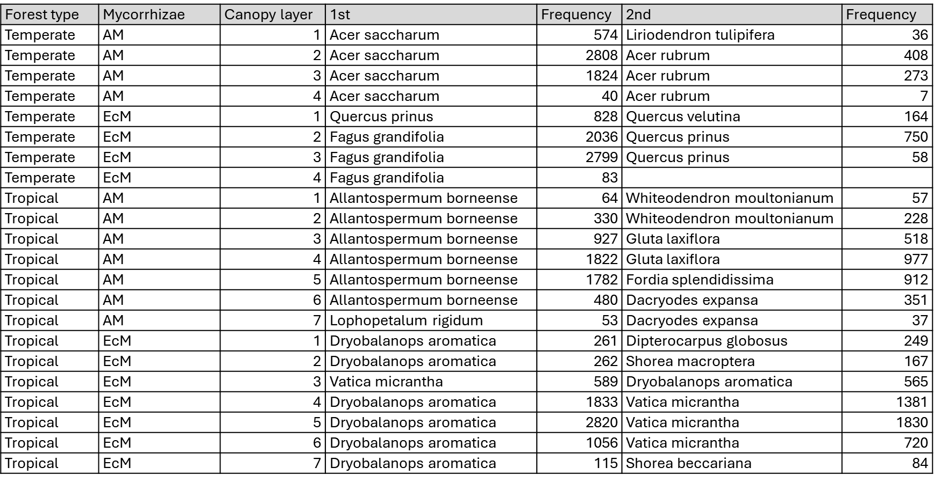
Notes:
Top 2 most frequent species in different canopy layers

